Slide 1
The Agile Inception Deck
Template

Slide 2
Financial Forms
James Sandoval
Notes:
Project name – pick a cool sounding name for your project
Sponsors – list your project sponsors here (the people with the money)
Putting your sponsors name boldly out there for all to see is a great way to get their engagement and attention (necessary for any successful project).

Slide 3

Why are we here?
For a decent grade in CSCE A401.
To make lives easier for people in UAA’s financial department.
To learn new languages and software development techniques.
Notes:
Write down all the reasons why your company would want to spend money on this project in the first place.
Then pick and highlight the most important one.

Slide 4
The elevator pitch
For [James Sandoval],
who [needs financial forms]
the [Financial Forms]
are a [web based system]
that [make financial forms more accessible and user friendly].
Unlike [the Excel documents, sticky notes, or word of mouth],
our project [will create an organized and user friendly system.].

Slide 5
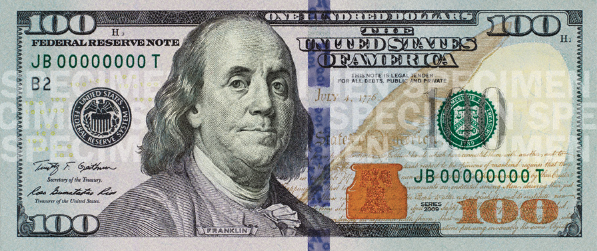
Product box
<Financial Forms>
fun picture
“Leave all of the technical stuff to us.”
<User friendly>
<Organized>
<Easily accessible>
Notes:
If you could walk into a store, and buy the shrink wrapped version of your software, what the design of the box look like and what would it say?
Point here is to get your team looking at your project through the eyes of your end customer.

Slide 6
The NOT list
IN | OUT
Web-based Ordering Form | Database for input data
Web-based Student Employment Form | Separated User and Admin web pages
Ability to print forms | Direct emailing of form data
Verification that required fields are completed | Separate pages on how to fill out forms
Simplicity in the user interface
Tooltip helps to guide users
UNRESOLVED
Notes:
List all the big ticket items you are (and are NOT) going to deliver within the scope of this project.
Before starting your project move all the UNRESOLVED ones to either IN or OUT.

Slide 7



Your project community
James Sandoval
The Benjamins
IT Services
COE Finance Staff
COE Staff
... is always bigger than you think!
Notes:
List everyone you are going to have to interact with at some point during the course of your project.
Goal is to start building relationships with these people and let them know we are coming down the tracks (before we actually get there).

Slide 8



Technical solution
Technologies:
<html, CSS, bootstrap>
<JavaScript libraries>
<HTML to PDF generator>
Danger!
Out of scope
Notes:
This is about letting people know how we plan on building this thing.
If there are any tools or libraries assumptions you are making list them here.
Also if there are areas of the application architecture that are risky highlight those too.

Slide 9

What keeps us up at night
<Will our client respond to our emails?>
<Too many tasks in one iteration within a short period of time>
<A teammate gives up or travels, leaving behind his responsibilities at the last minute.>
Notes:
This is your chance to call out any craziness you’ve heard while building the deck, and having a frank conversation with your sponsors and your team about how you are going to handle it.
This is perhaps on of the most powerful slides in the deck – it’s your chance to ask for whatever you need to be successful and the consequences if you don’t get it.
Use it!

Slide 10
The Benjamins
# | Role | Competencies/Expectations
1 | Daniel Card | HTML, Javascript, Unit Testing, and Black Box Testing Responsible implementing different features on the forms and final testing of the product.
2 | Dari Donkuro | HTML, Javascript, Unit Testing, and Black Box Testing Responsible for the layout of the forms for display in a web browser.
3 | Brent Gonzales | Responsible for emailing the customer. Leads the meetings with the customer on the development of the product. Records all feedback from the customer.
4 | Rob Pantaleone | Javascript, PDF resources, Unit Testing, Black Box Testing Responsible for creating a PDF from the data entered into the web form.
Notes:
Set expectations around who you are going to need and what kind of skills they will need to have to pull this off.
Use names if specific people are important (i.e. Billy is the only guy who can do X).

Slide 11

How big is this thing?
Ship it!
Development
Testing
Acceptance
6 wks
1 wk
1 wk
This is a guess. Not a commitment.
Notes:
Give your sponsors some idea of how big this thing is (1, 3, or 6 monther).
Before you can complete this slide you and the team should create and estimate a high-level story list for the project.
This isn’t a commitment (too many unknowns). It’s just a really rough guess. Don’t treat it as anything else.

Slide 12
Trade-off sliders
 | The classic four
 | Feature completeness (scope)
 | Stay within budget (budget)
 | Deliver project on time (time)
 | High quality, low defects (quality)
ON
OFF
ON
OFF
ON
OFF
ON
OFF
 | Other important things
 | Ease of use
 | Don’t make me think!
 | Detailed audits (log everything)
 | Maintain flexiblity
ON
OFF
ON
OFF
ON
OFF
ON
OFF
Notes:
When push comes to shove, something has to give. Here we want to be clear on what that is.
On agile projects we flex on scope. But there could be others factors at play here so get ready to listen as you customer tells you which forces can bend (scope) and which are written in stone (usually budget).
Slider rules:
1. No two sliders can occupy the same level.
2. List other important project factors down below.

Slide 13
The first release
Ship it!
Development
Testing
Acceptance
6 wks
1 wk
1 wk
4 people, less than 3 months, $0
Notes:
Stakeholders are usually interested in two things:
How much is this going to cost.
When is it going to be done.
Here we do our best to answer those two questions so they can decide if the project is still worth doing by showing them what it’s going to take.

Slide 14

Learn more
http://agilewarrior.wordpress.com
Buy the book!
Twitter:
@jrasmusson
Notes:
That’s it! Create your deck.
Put it somewhere visible for all too see.
And update it when things change.
Good luck!

